Slide 1
By Robert Danis
SMART MIRROR

Slide 2
Roadmap
Who am I
IOT
Why a Smart Mirror
Early Stages
Challenges
Where am I now
Improvements/Alternatives
Conclusion

Slide 3

Who am I

Slide 4
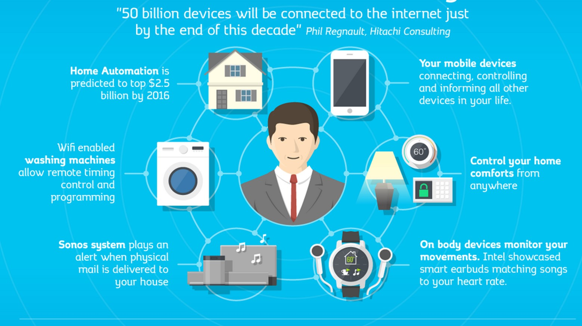
IOT Now

Slide 5
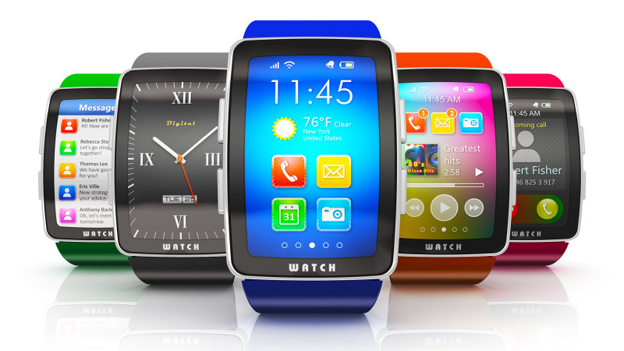
IOT in the Future

Slide 6
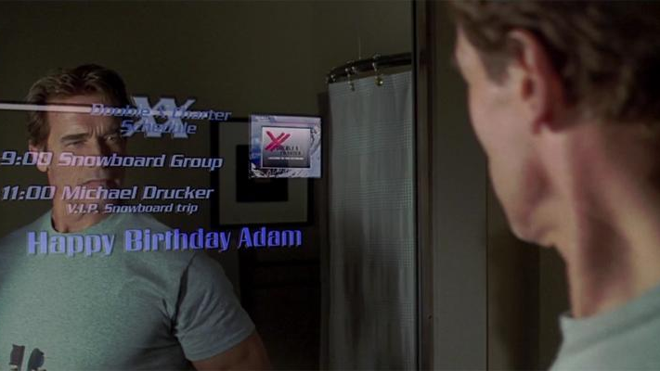
Why a Smart Mirror?

Slide 7
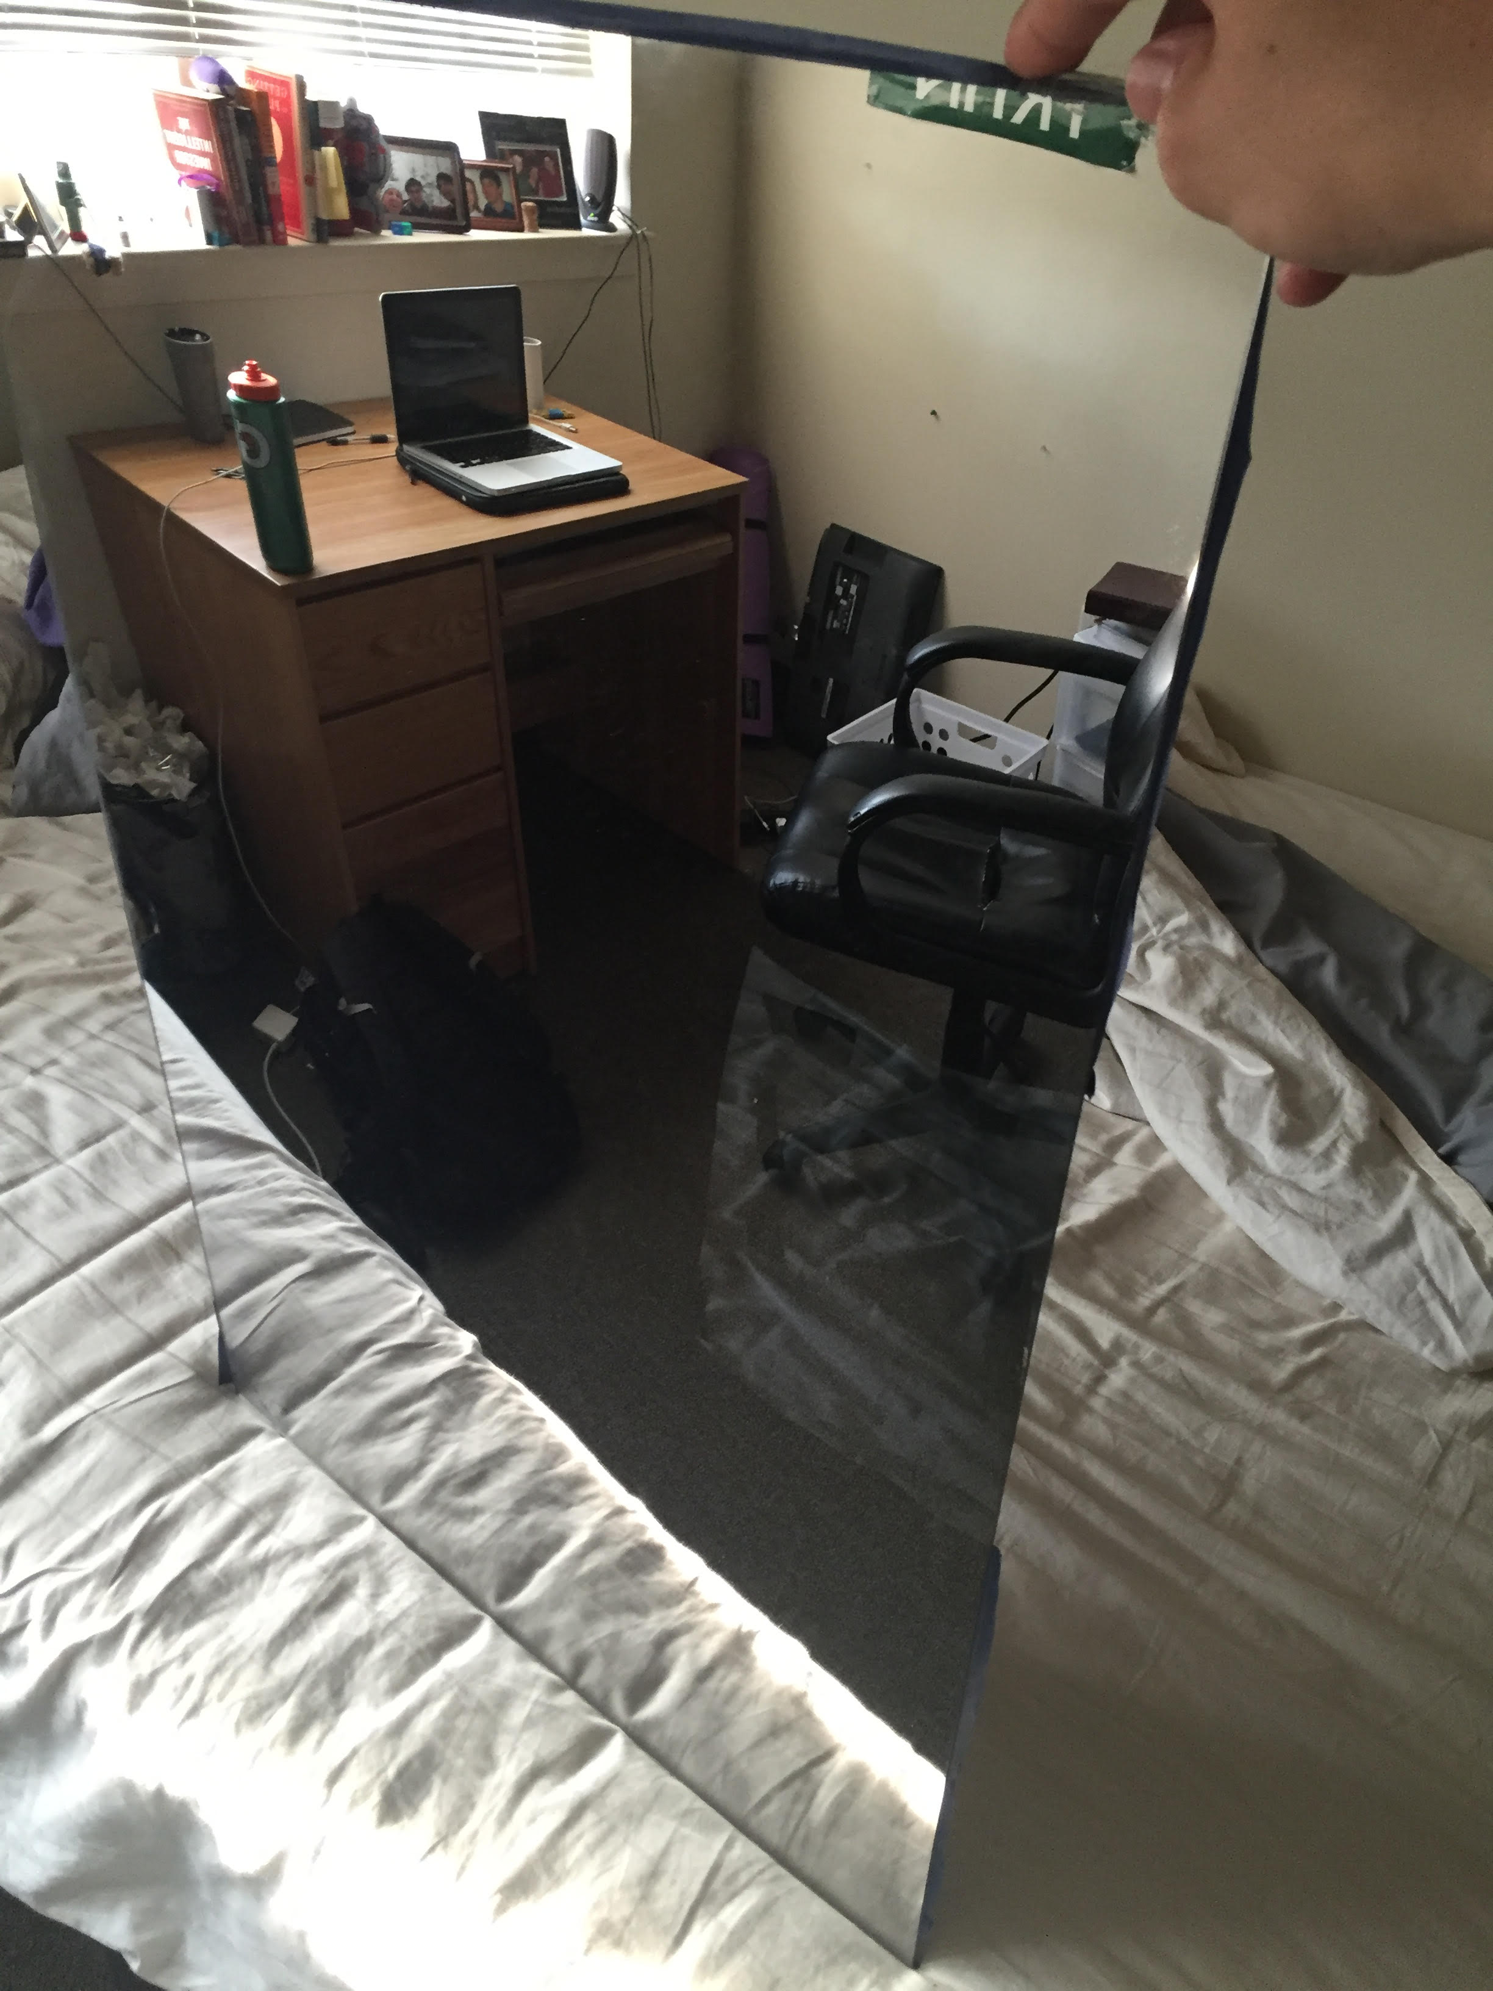
Early Stages

Slide 8
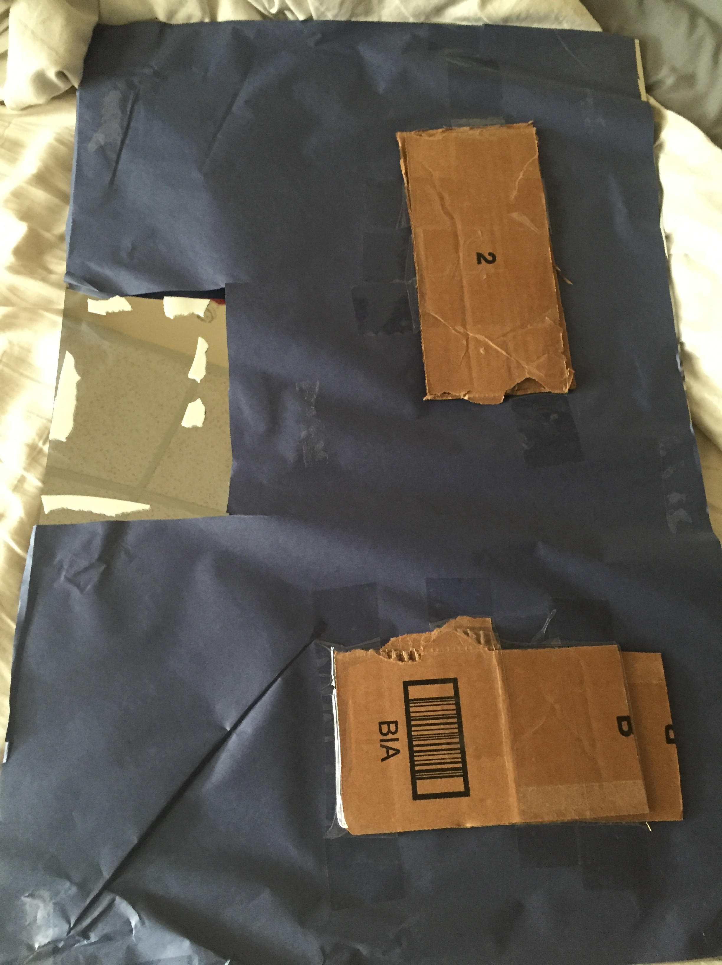
Early Stages continued

Slide 9
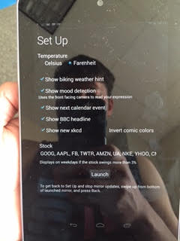
Early Stages continued

Slide 10
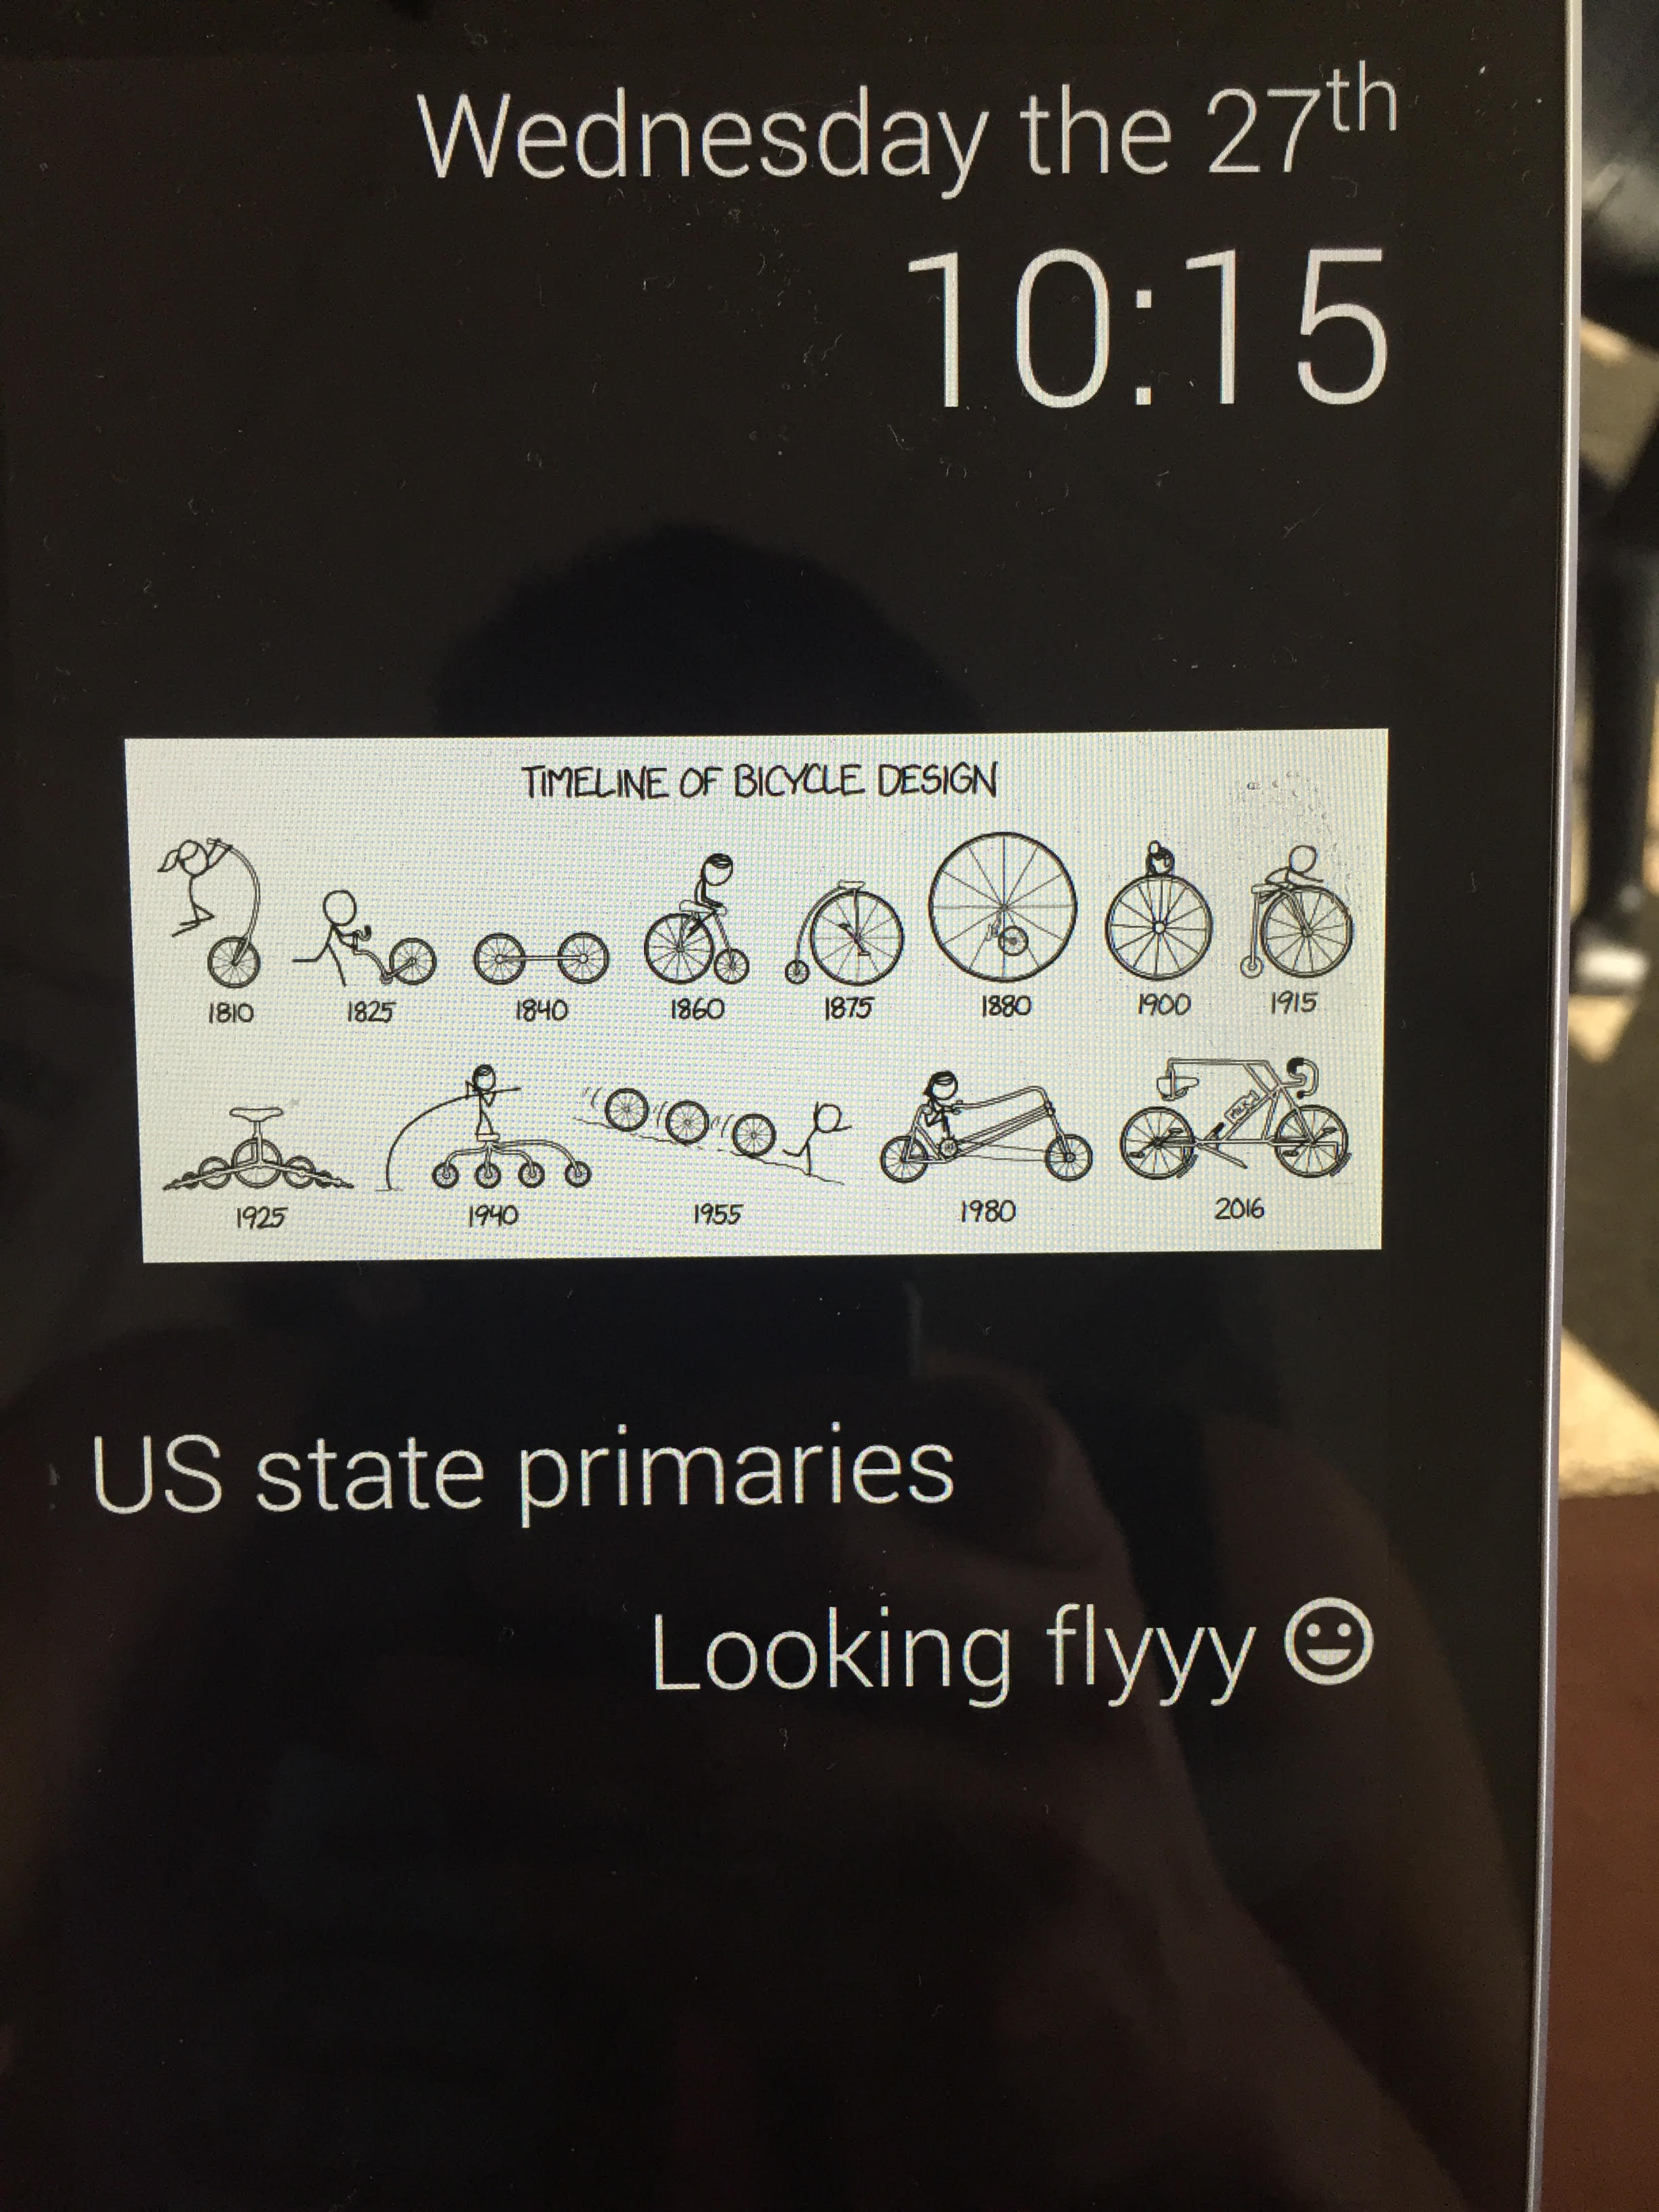
Early Stages continued

Slide 11
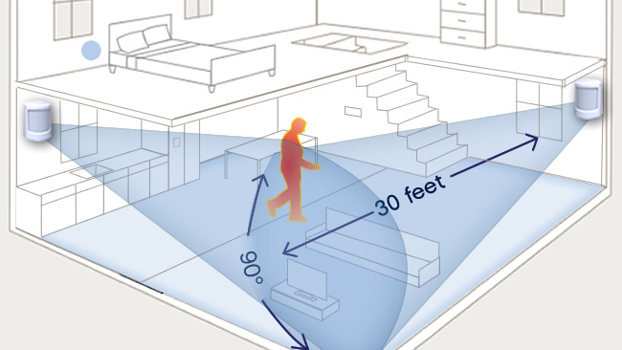
Challenges

Slide 12

Challenges con’t

Slide 13
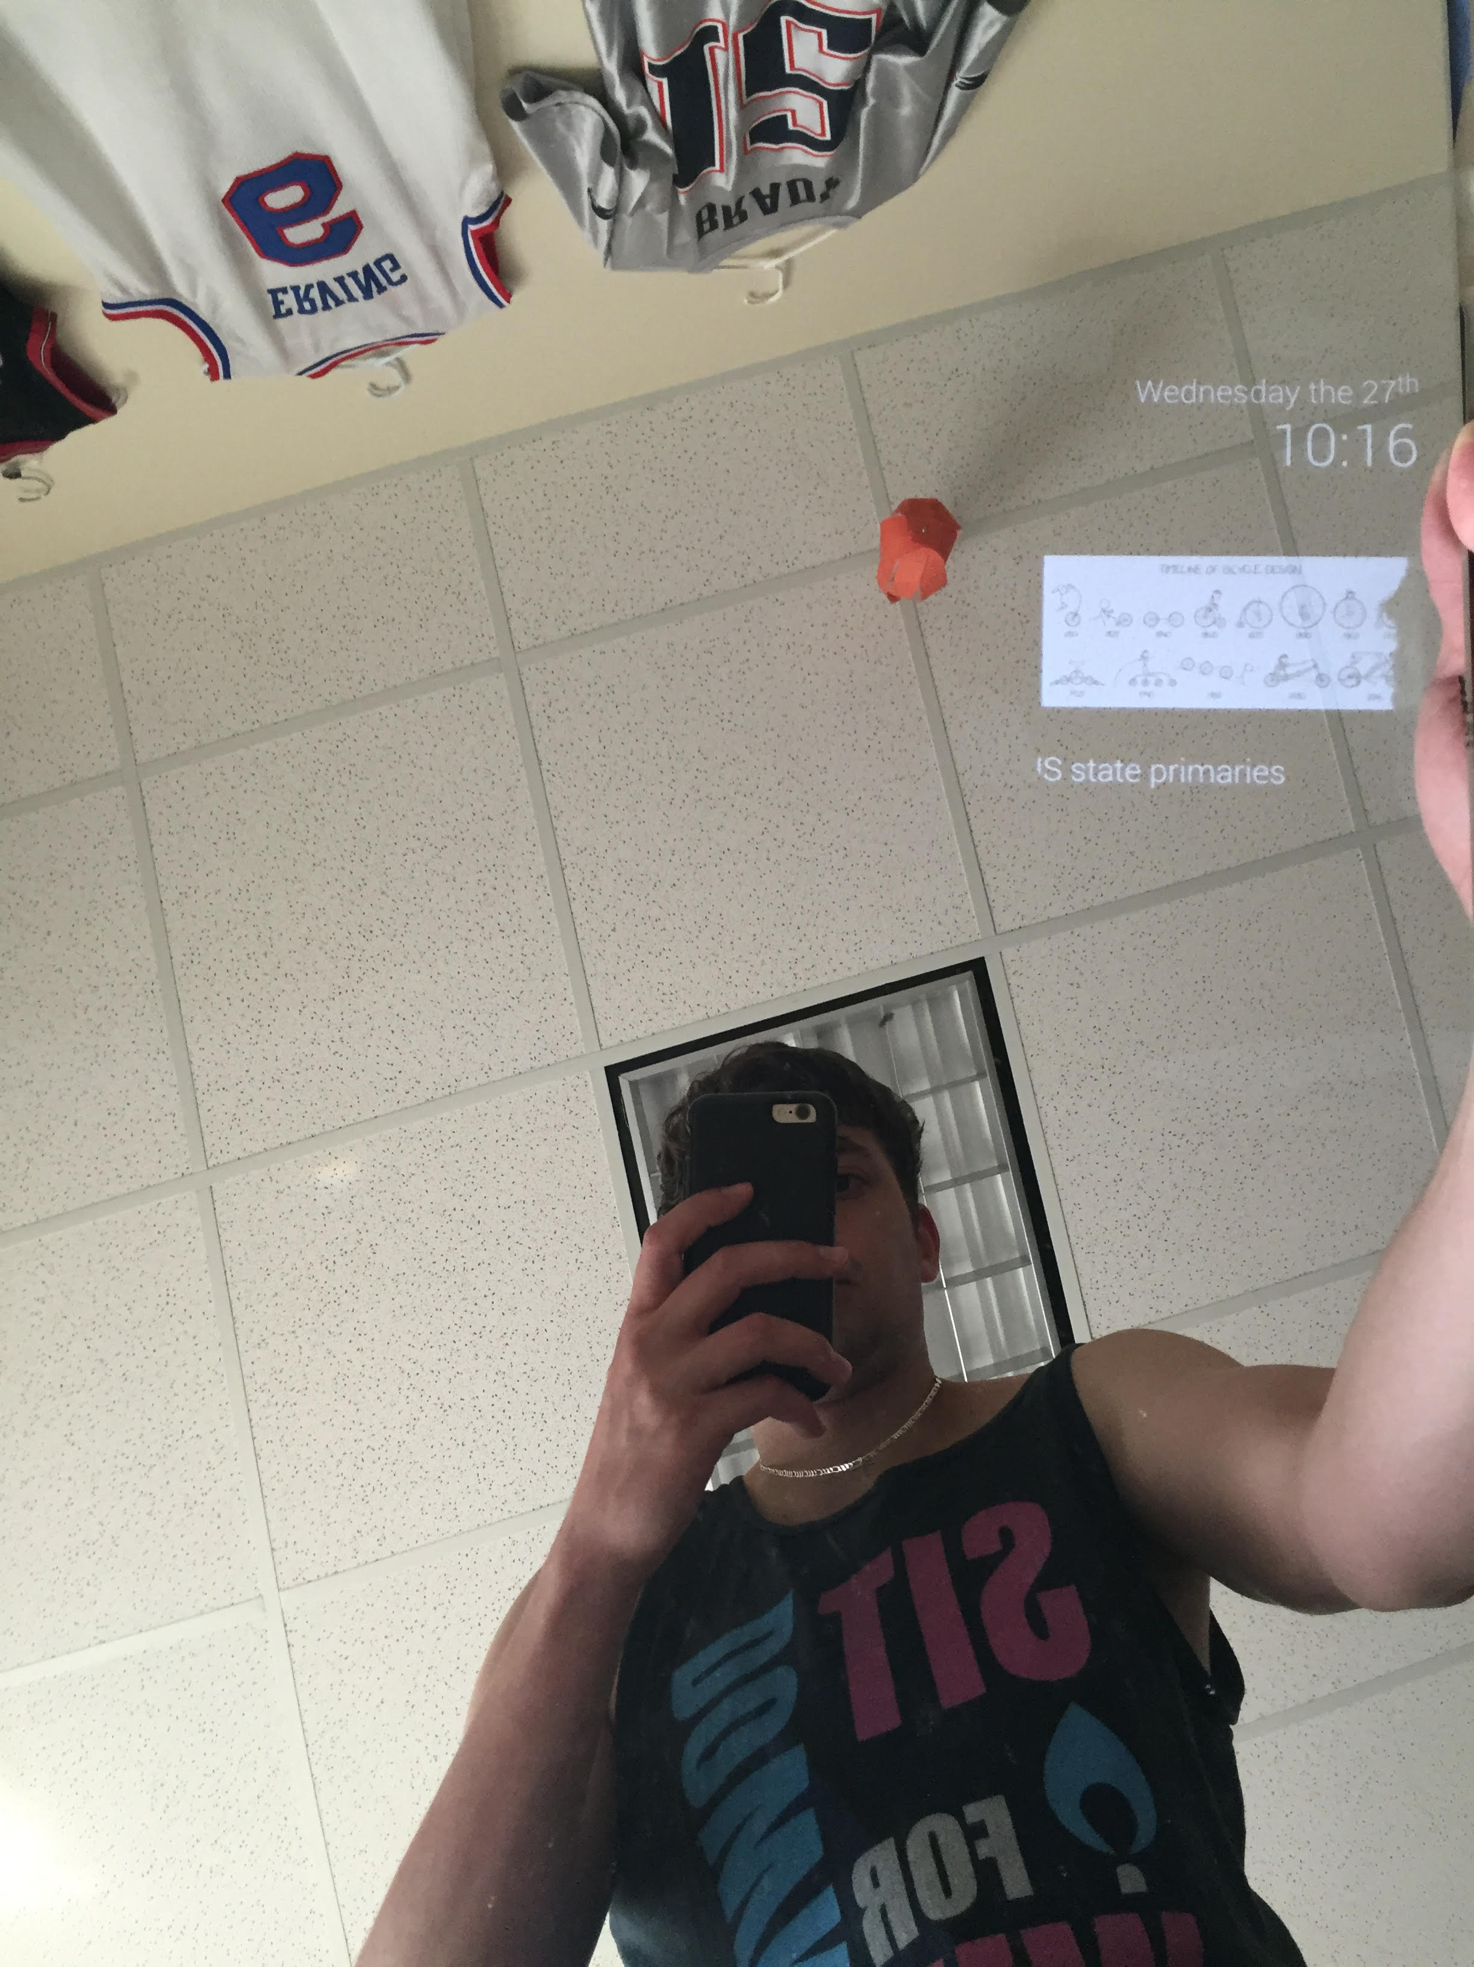
Where am I now?

Slide 14
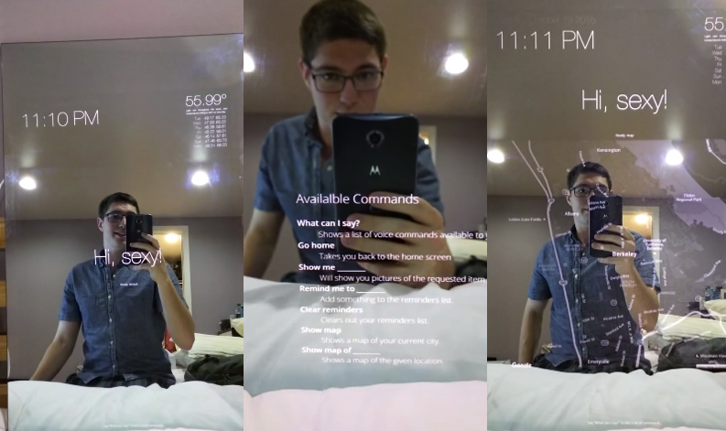
Improvements/Alternatives

Slide 15
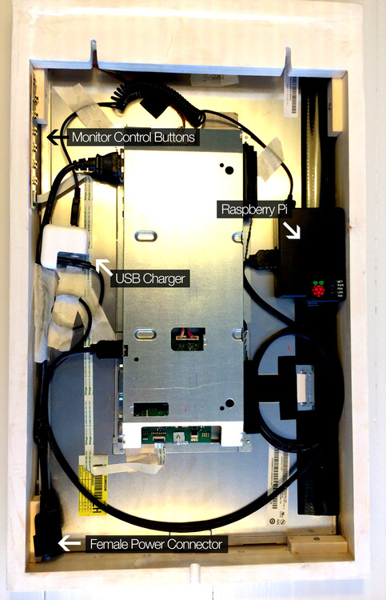
Improvements/Alternatives

Slide 16
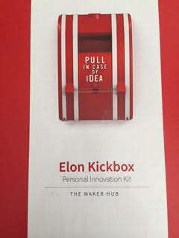
Conclusion

